Slide 1


Hanging Out With Your Past Self In VR:
Time-Shifted Avatar Replication Using Kafka Streams
Greg Fodor
@gfodor
AltspaceVR
https://altvr.com/kafka

Slide 2
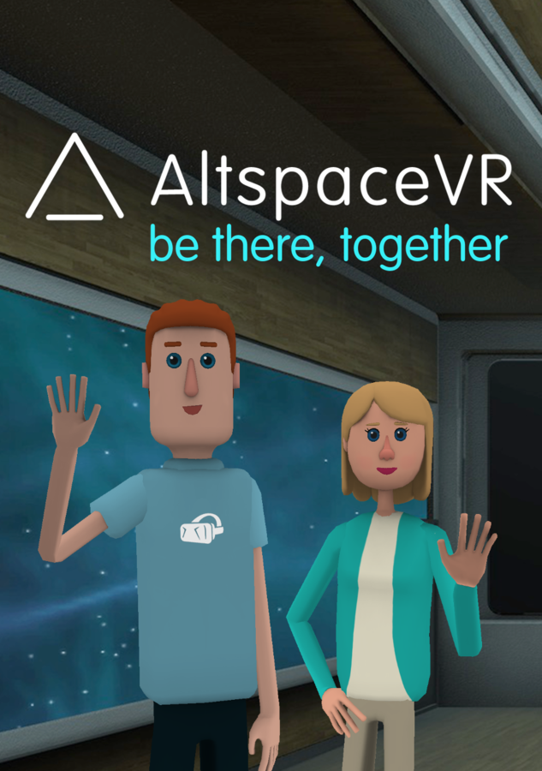
https://altvr.com/kafka

Slide 3
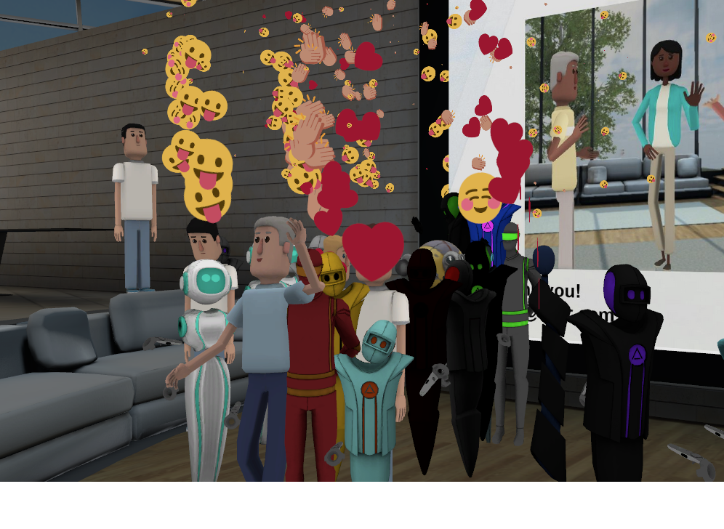
The best shared VR platform
https://altvr.com/kafka

Slide 4
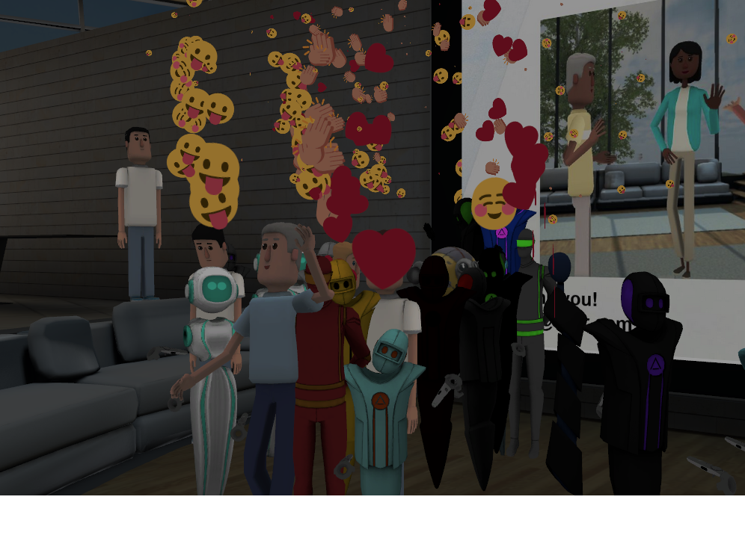

Comfort and ease of use
https://altvr.com/kafka

Slide 5

Cross platform
https://altvr.com/kafka

Slide 6
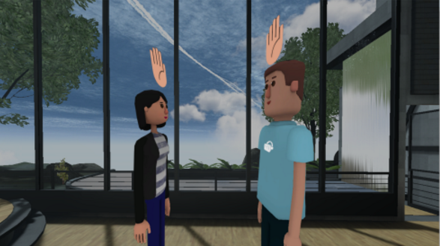
Human connection

Slide 7
Stuff we’ve shipped
https://altvr.com/kafka

Slide 8
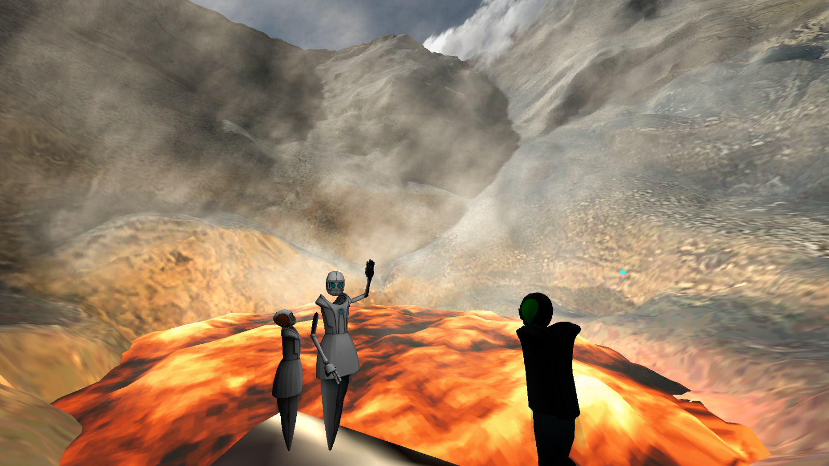
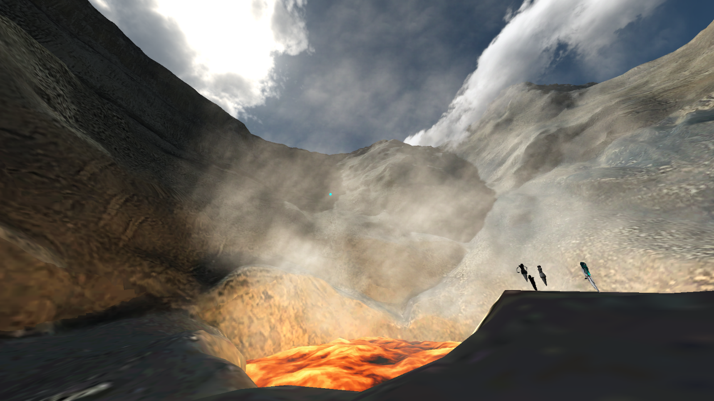
Volcano tours
https://altvr.com/kafka

Slide 9
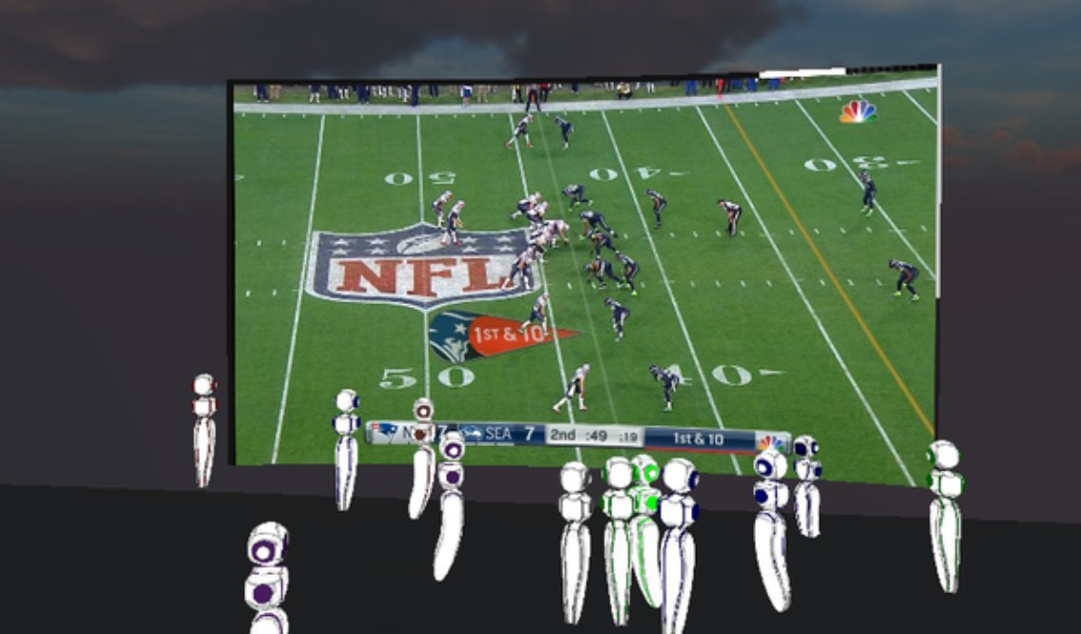
Super bowl party
https://altvr.com/kafka
https://altvr.com/kafka

Slide 10

Full
Body
Mocap
https://altvr.com/kafka

Slide 11

Tabletop games
https://altvr.com/kafka

Slide 12
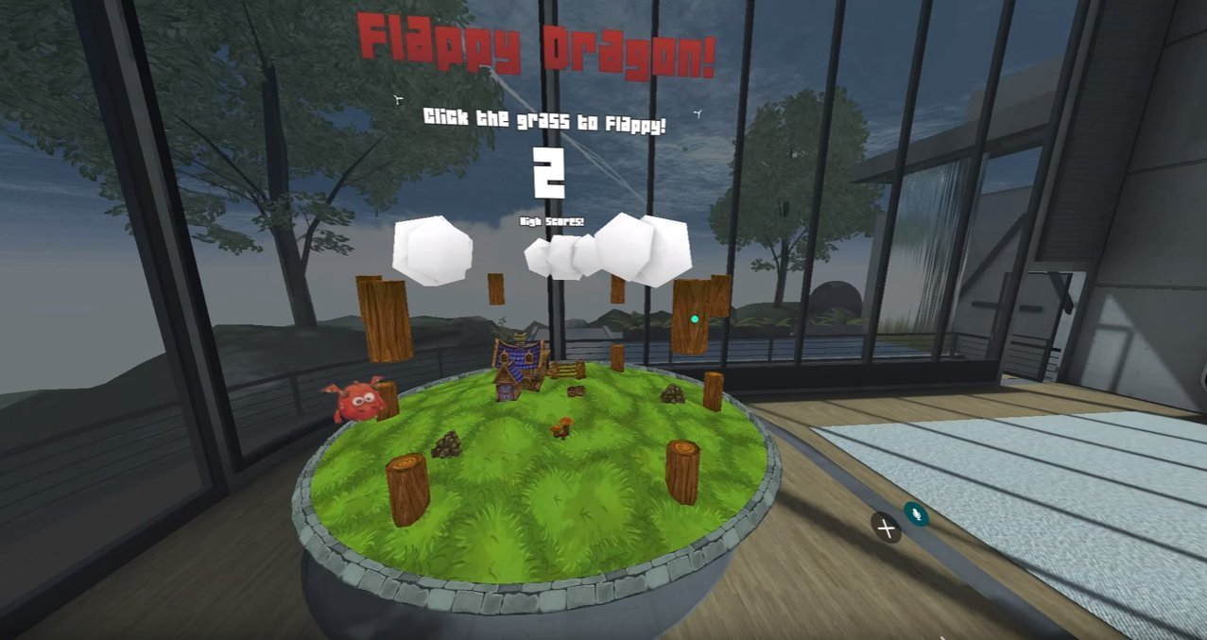
Javascript SDK
https://altvr.com/kafka

Slide 13

VR Events

Slide 14

Use cases
https://altvr.com/kafka

Slide 15

VR Mirroring + Capture
https://altvr.com/kafka

Slide 16
Ability to mirror, capture, and
replay avatars
https://altvr.com/kafka

Slide 17
Video
https://altvr.com/kafka

Slide 18
VR Mirroring + Capture
https://altvr.com/kafka

Slide 19
Use cases for mirroring
https://altvr.com/kafka

Slide 20
Use cases
https://altvr.com/kafka

Slide 21
Use cases
1000+ RSVPs
https://altvr.com/kafka

Slide 22
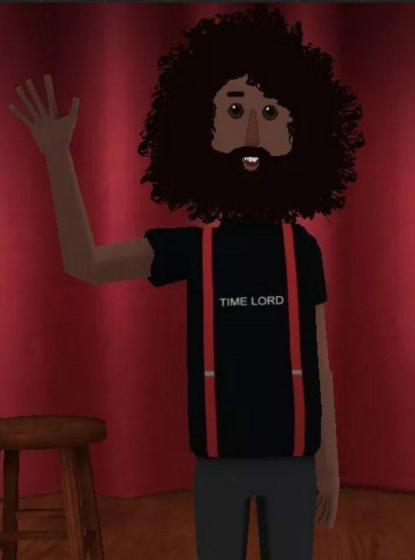
“Real” Reggie
“VIP” Room
https://altvr.com/kafka

Slide 23
“Real” Reggie
“VIP” Room
Room 1
Room 2
Room 3
Room 4
“Mirrored” Reggies
https://altvr.com/kafka

Slide 24
Use cases for capture/replay
https://altvr.com/kafka

Slide 25
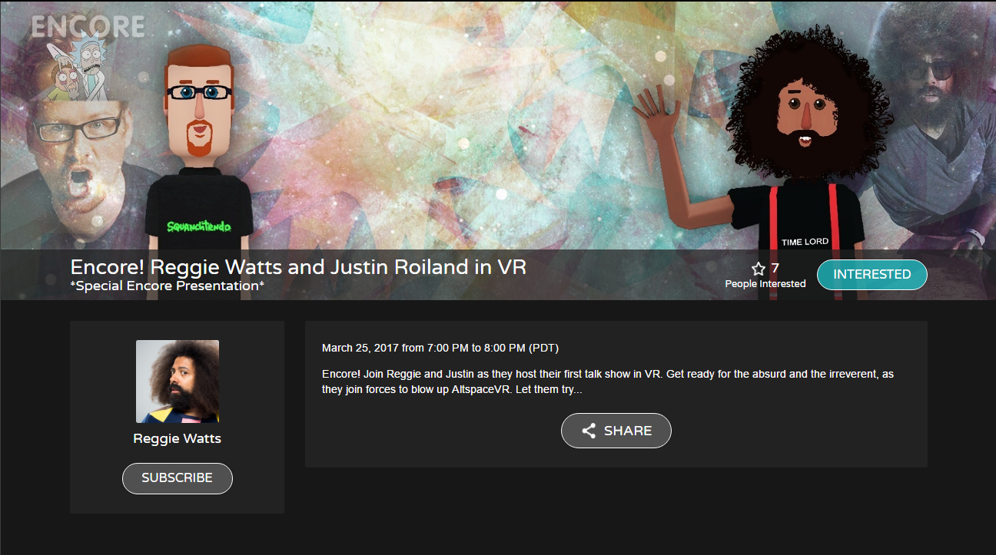

Slide 26

https://altvr.com/kafka

Slide 28

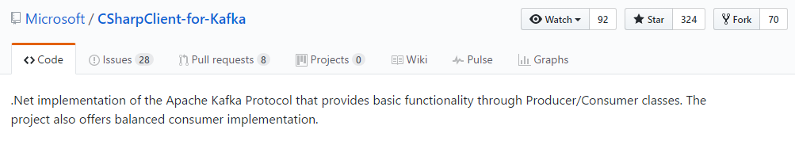

Slide 29
Kafka Streams API

Slide 30
Kafka Streams API Stream processing: it’s not just for analytics!

Slide 31
- Independent capacity - Arbitrary transformations - Flexible and simple ops
Kafka Streams API

Slide 32
- Build cohesive, re-usable topologies - Design for extensibility - Apply patterns + avoid pitfalls
Kafka Streams API

Slide 33
Job #1: Game Streams

Slide 34
- Real-time netdata transformation - Routing between Photon servers - Stateful, due to Photon protocol
Game Streams
Create a logical stream across Photon servers

Slide 35
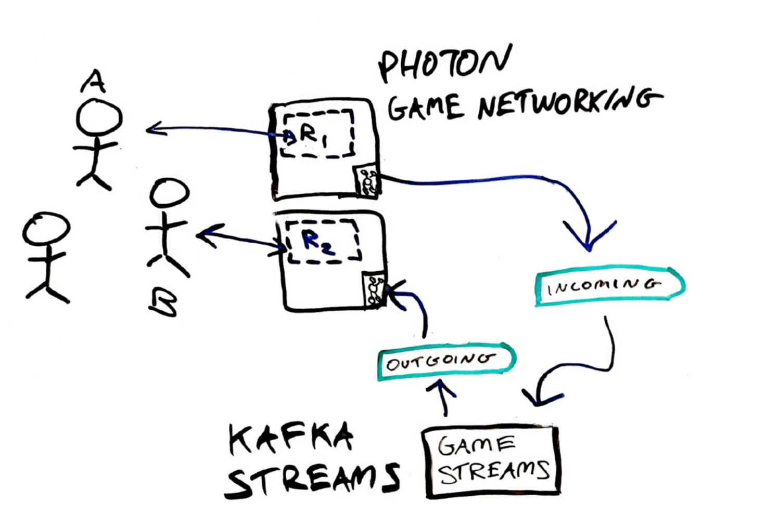
“Mirror User A to room R2”

Slide 36
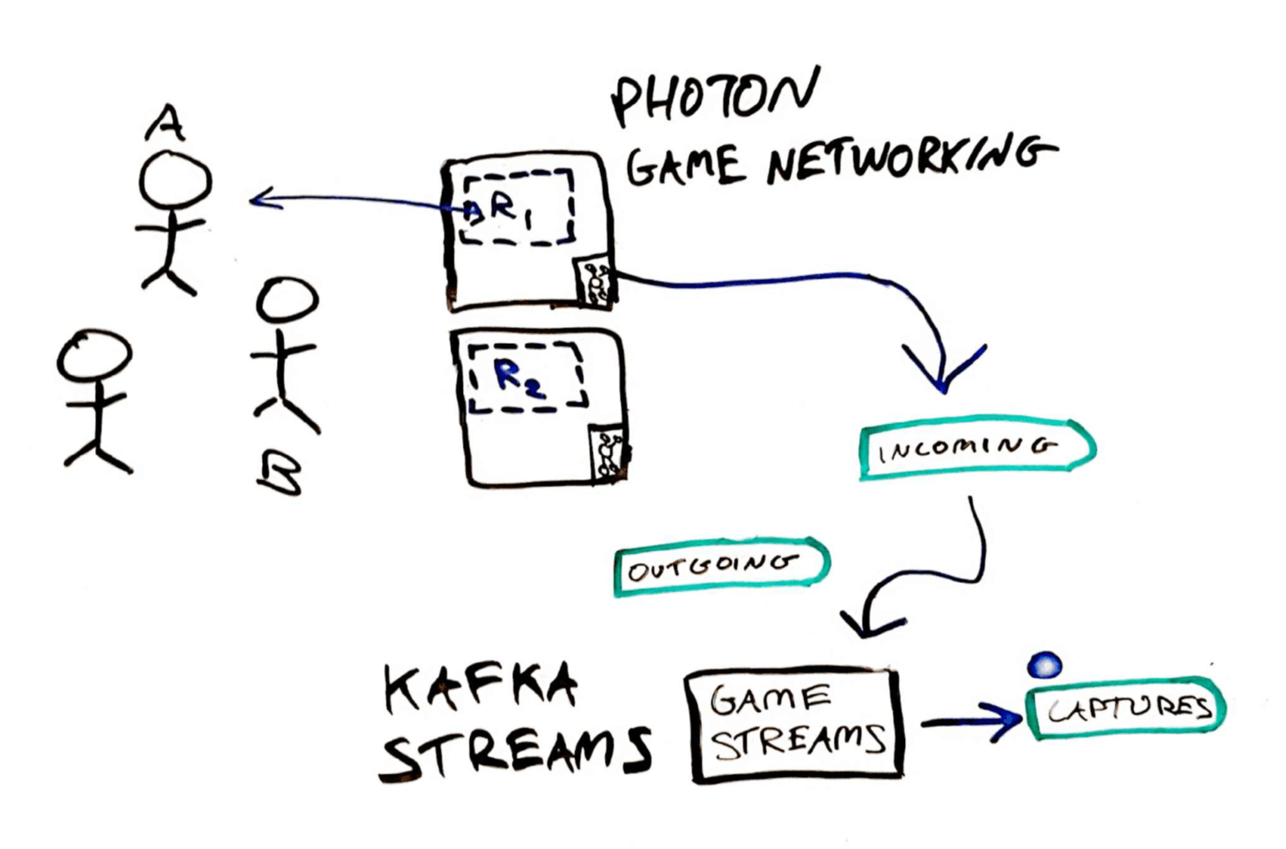
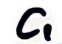
6 months later: “Capture User A”

Slide 37
Job #2: Playbacks

Slide 38
- Load capture data (Kafka/S3) - Timed emission - Checkpointing, looping, filtering
Playbacks
Replays captured data

Slide 39
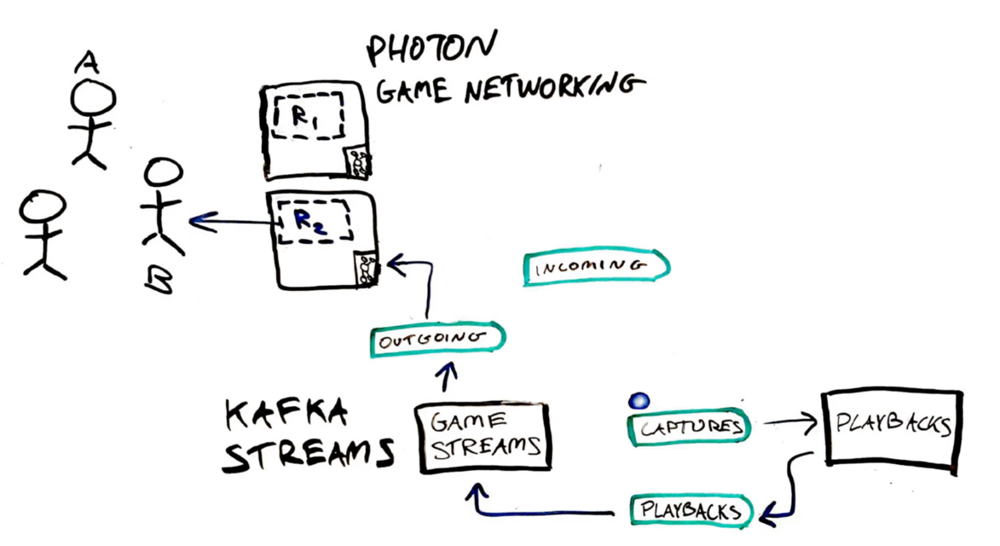
“Playback capture to room R2”

Slide 40
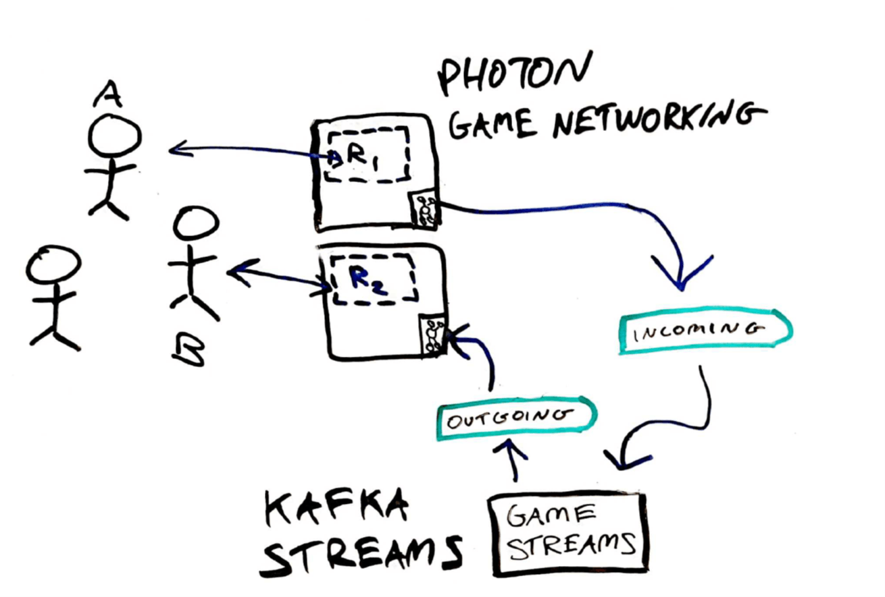
“Mirror User A to room R2”

Slide 41
- Build cohesive, re-usable topologies - Design for extendibility - Apply patterns + avoid pitfalls
Kafka Streams API
GameStreams job allows:
User capture/mirroring
Interactable object capture/mirroring
VoIP, avatar transforms, VR emojis payloads
Entire room capture/mirroring

Slide 42
- Build cohesive, re-usable topologies - Design for extensibility - Apply patterns + avoid pitfalls
Kafka Streams API
Design names, record types generically
Build in mechanisms for parameterization + control
Use avro and schema registry
Job code is not throwaway! Build accordingly

Slide 43
Demo!
https://altvr.com/kafka

Slide 44
Patterns + Pitfalls

Slide 45
Patterns + Pitfalls

Slide 46
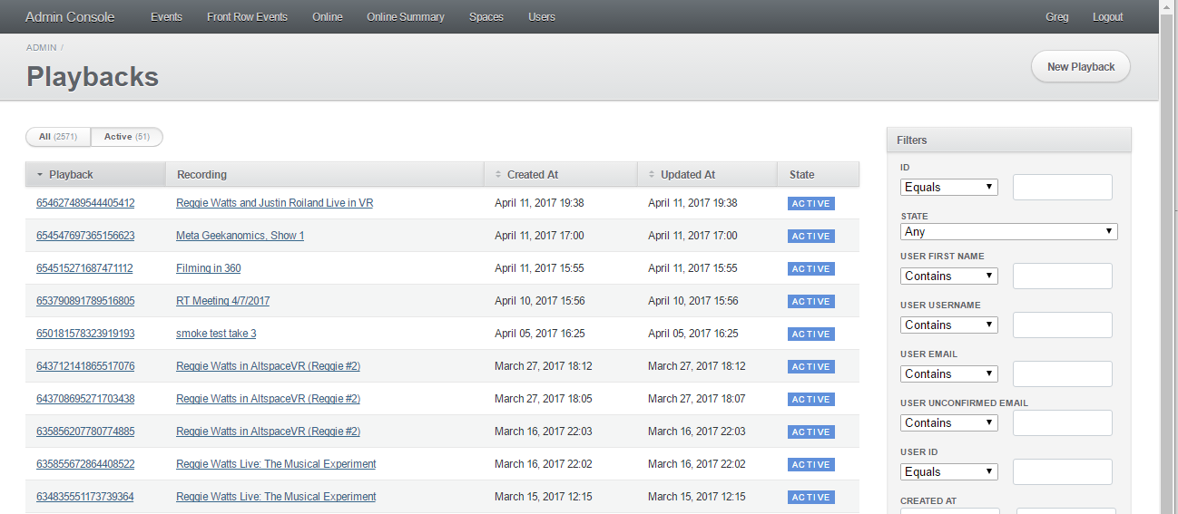
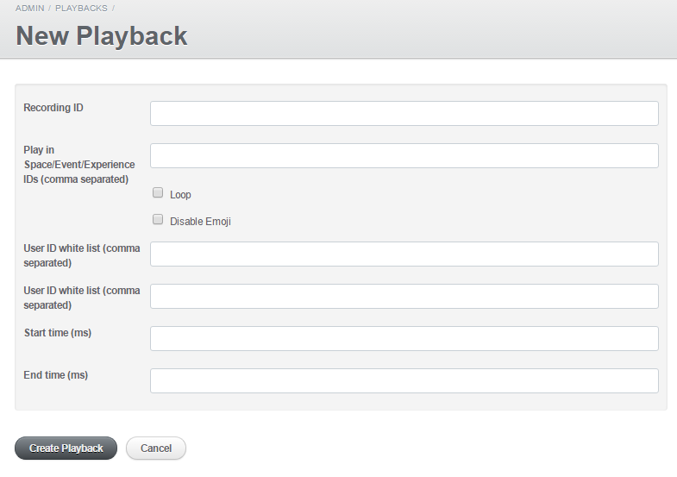
Config KTables Drive job behavior via OLTP state In our case, users interact with Rails API to control mirroring + captures

Slide 47
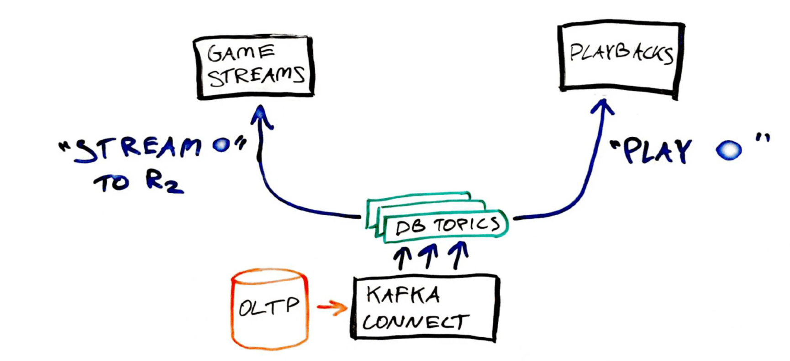
KIP-99 Global Tables https://cwiki.apache.org/confluence/display/KAFKA/KIP-99%3A+Add+Global+Tables+to+Kafka+Streams

Slide 48
Prefer declarative OLTP table state Database tables state should describe “how the world should be” not “steps to perform” Job’s duty is to make the world look like the one desired “A stream should exist from playback A to room B” not “Right now, create a stream from playback A to room B” Straightforward to test + verify: does desired world match up with reality? Easier to reason about in failure cases

Slide 49
Keep consistent topic naming Kafka Stream jobs involve a lot of source + intermediate topics We prefer: [<data source>|<job application id>]-<avro record type>[_<specifier>]-<partition key> Ex: oltp_db-user-user_id job_playbacks-photon_instantiations-game_stream_id

Slide 50
Expose jobs as microservices We prefer Thrift RPC
https://altvr.com/kafka

Slide 51
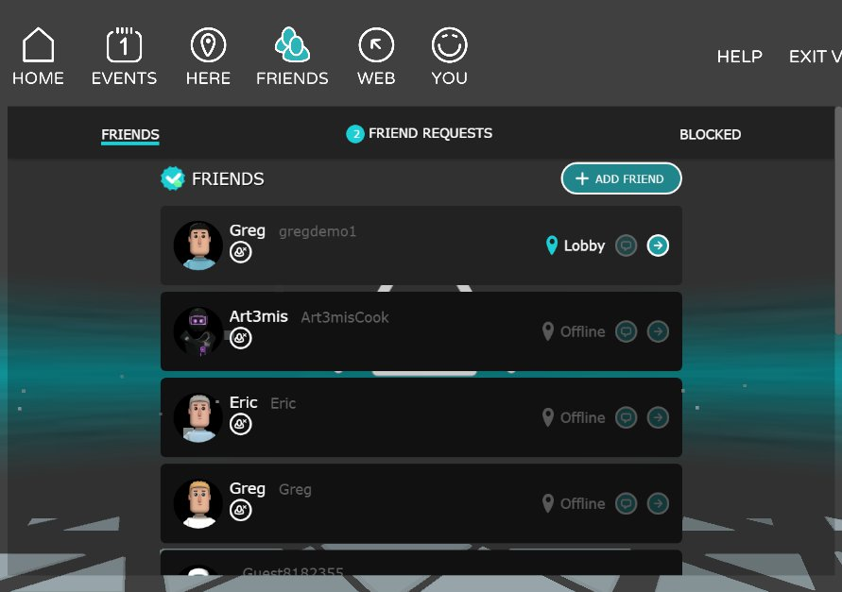
Example: Presence
https://altvr.com/kafka

Slide 52
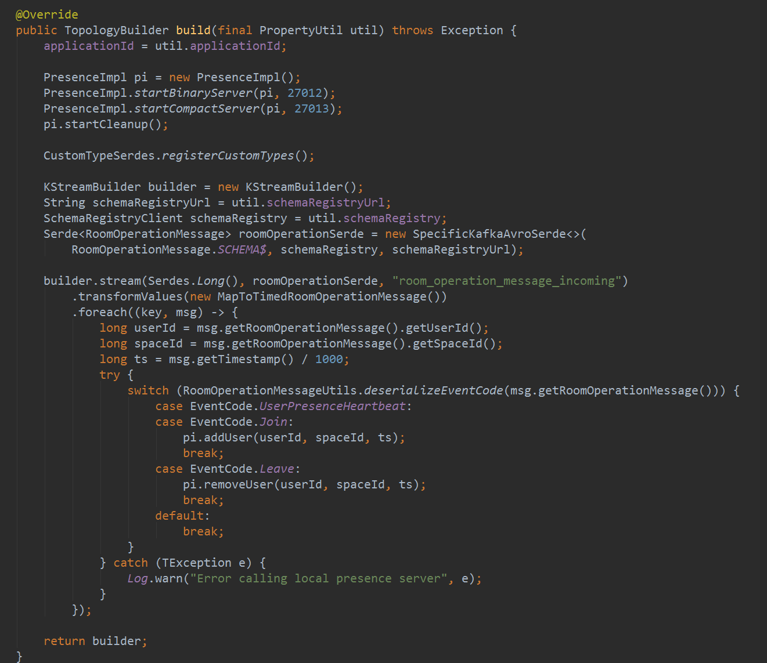
https://altvr.com/kafka

Slide 53
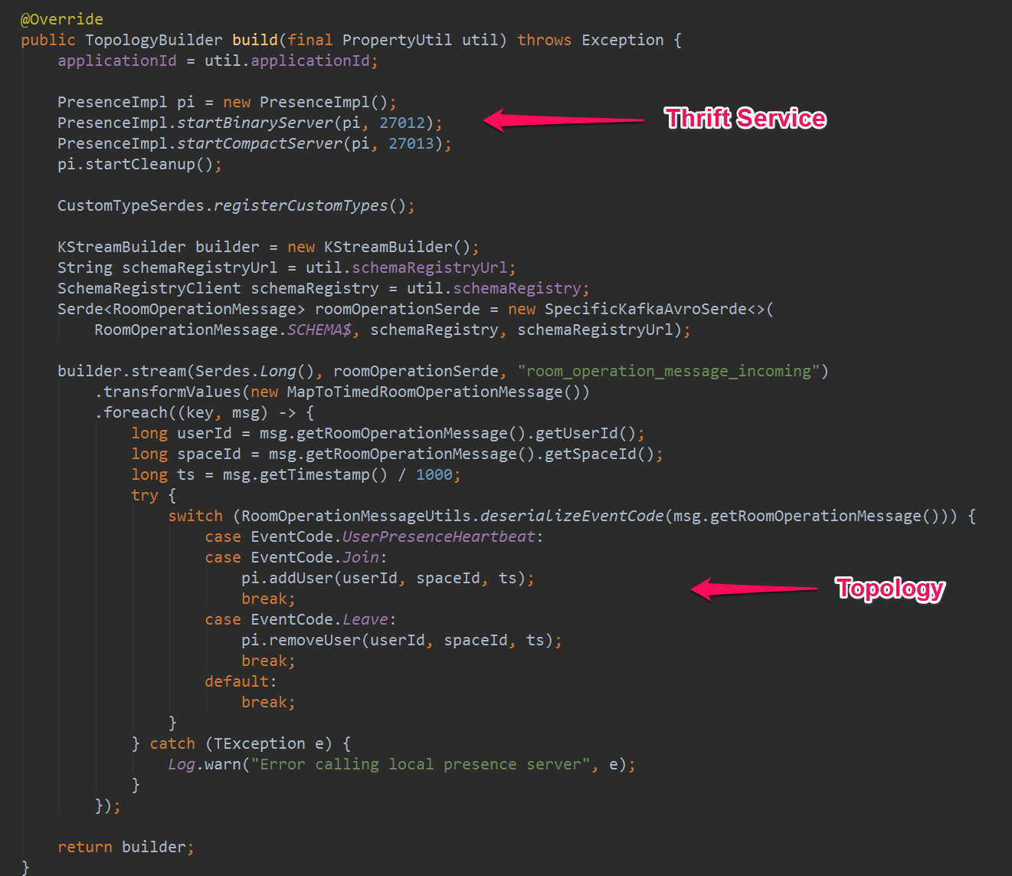
https://altvr.com/kafka

Slide 54
Small State Stores Often times you have state store data that is short lived and unneeded after a certain amount of time For us, about ¾ of state stores in jobs described meet this criteria It’s desirable to set things up so you can have Kafka ensure stale xlog data is purged Even if you are deleting keys manually + assuming compaction, this ensures xlog bounding
https://altvr.com/kafka

Slide 55
Small State Stores For a state store where only keys within a duration N ms are guaranteed to be retained, configure topic: segment.bytes=X,retention.ms=N,cleanup.policy=delete with a reasonable X being approx working set size, as Kafka will always retain up to 2 * X xlog bytes ex: segment.bytes=1048576,retention.ms=604800000,cleanup.policy=delete will result in a state store transaction log that will make keys last accessed > 7 days ago eligible for deletion, with at most 1MB of stale keys sitting in transaction logs
https://altvr.com/kafka

Slide 56
RocksDB range scans Did you know that RocksDB stores keys lexicographically sorted? Kafka Streams exposes range() queries on persistent state stores!
https://altvr.com/kafka

Slide 57
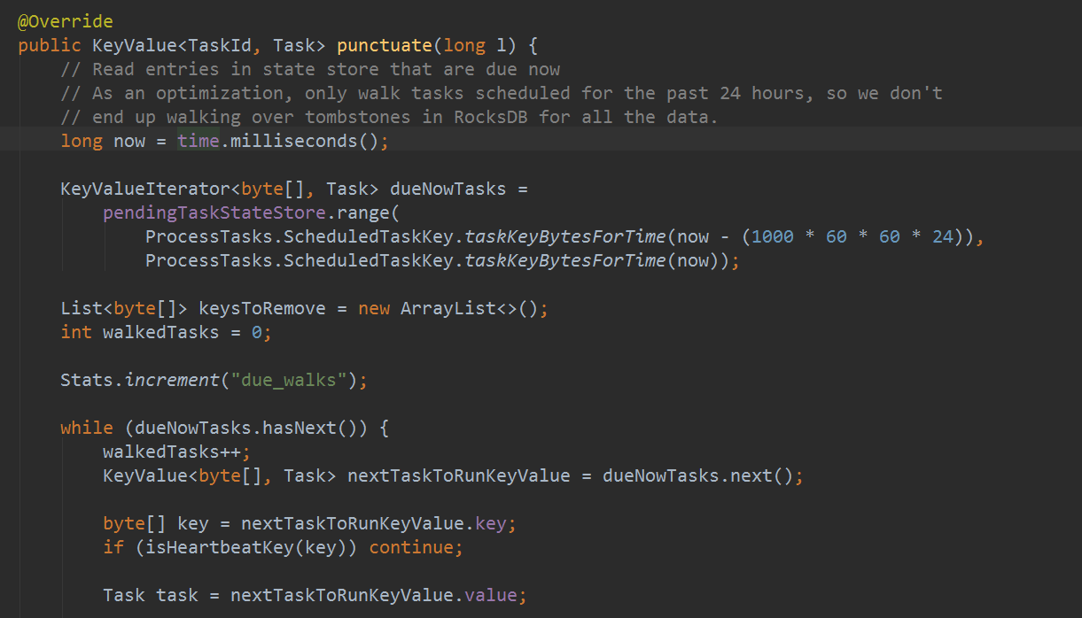
Example: Scheduled tasks Keys in “tasks” topic are a composite key of <timestamp, id> Allows range queries for upcoming tasks (local to partition, obviously)
https://altvr.com/kafka

Slide 58
Dark staging jobs Eventually you will need to deploy a staging version of a job into prod for integration testing while known-good version is serving users. Ensure you bake in the necessary degree of freedom! (Duplicate topics, application ids, etc.)
https://altvr.com/kafka

Slide 59
Patterns + Pitfalls
https://altvr.com/kafka

Slide 60
KTable rematerialization Cold nodes read *entire* KTable transaction log for each KTable on startup. (Of course!) Not something you’re likely to experience except during a failure. You could be in for a surprise! Easy to force a rematerialization to test: stop job, remove state dir from job work directory, restart. (But you should probably check your xlog topic sizes first) In our case, AWS EBS I/O throttling caused us to be unable to bring a fresh node up! Ensure topic xlog doesn’t grow unbounded: - Ensure you delete dead keys explicitly and have proper compaction policies set on xlog topics - Or, use pattern discussed previously if data can be purged after time duration
https://altvr.com/kafka

Slide 61
Reset switches + flushing Sometimes KTables topics or entries need to be forcibly rematerialized/flushed/read from beginning. For example: KTable topic exists before first job run. Or, something broke. Handy to build in mechanisms to: - Reset consumer offsets to zero - For OLTP/Connect-backed KTable data, force a no-op update to database record(s) to flush - In Rails, ActiveRecord#flush May be less necessary in newer versions of Kafka Streams (ex due to KAFKA-4114 + bugfixes) Handy topic consumer group offset resetter routine, pass in job Properties: https://gist.github.com/gfodor/a4f5e4721e959766e75e4c901bf42890
https://altvr.com/kafka

Slide 62
Conclusion Kafka Streams has been amazing for us. Shown so far, we have jobs for: - VR Mirror/Capture/Playback - Presence - Scheduled tasks We are also using it for: - Real time game telemetry ETL - VR Capture archival to S3 - Real-time push messaging
https://altvr.com/kafka

Slide 63
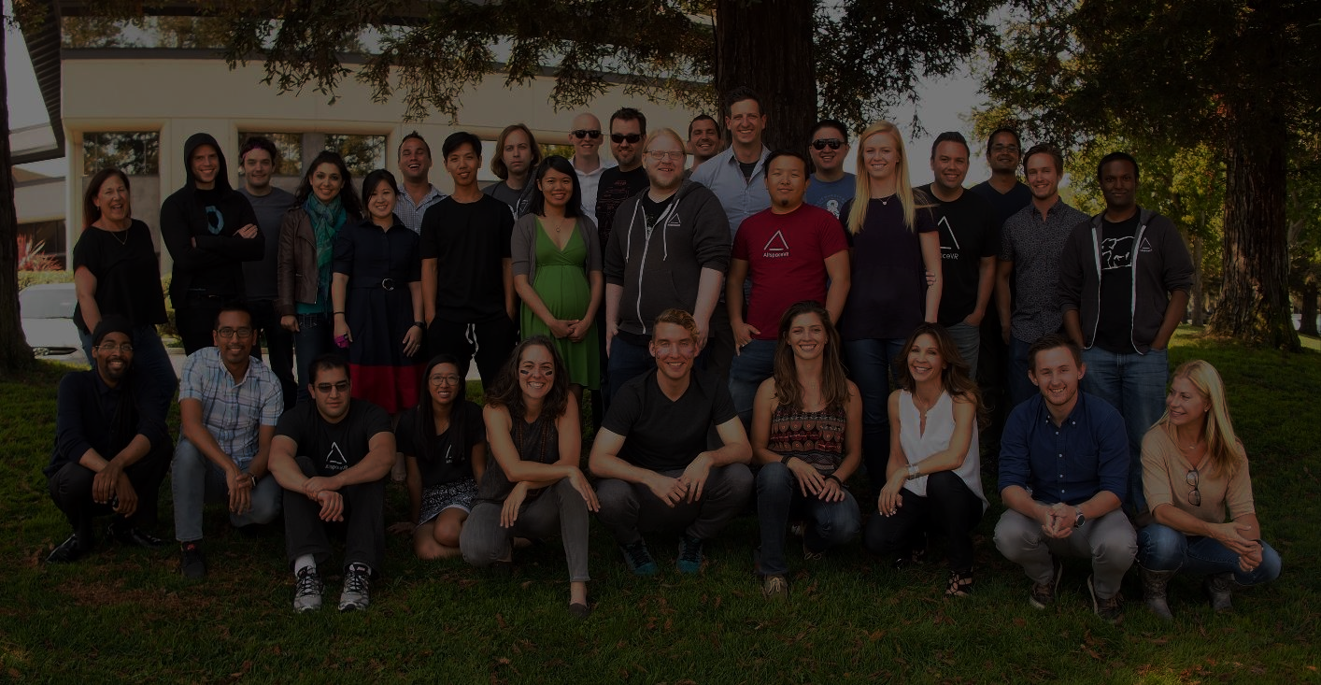
Conclusion Thanks to the Confluent team and the Kafka community! Sound fun? We are hiring ☺ See you in VR!
greg@altvr.com https://altvr.com/careers
https://altvr.com/kafka

